Slide 1
Chapter 11 Reading and Writing Data
By
Hyung Jae (Chris) Chang
Troy University

Slide 2


TXT Files
Contains only plain text; is defined as a pure sequence of character codes.
Appears with an extension “.txt”.
To open it in Python code, we need to use the “open” function which return a “file object”.
Mode
r: (default mode) Opens a file for reading
w: Open file for writing, if file do not exist, create one
a: Open file to append data to end of file, if file do not exist, create one
b: Open file in binary mode
r+: Open file for reading and writing (no creation)
w+: Open/create file for writing and reading, discard existing content
a+: Open/create file for appending data to the end of file

Slide 3
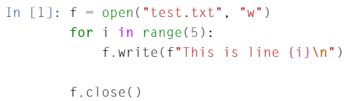
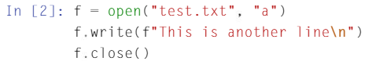
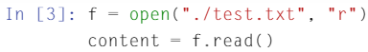

Example
Writing to a file
Appending a file
Reading a file

Slide 4
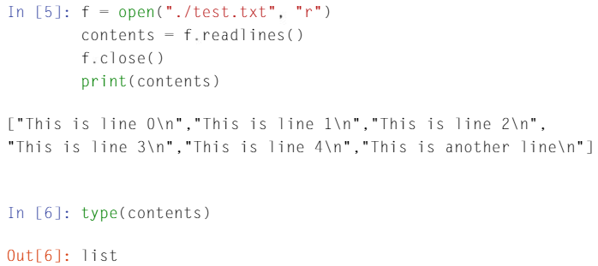
Example (cont.)
Reading the contents in the files line by line and store it in a list (using f.readlines() function where f is a file object)

Slide 5
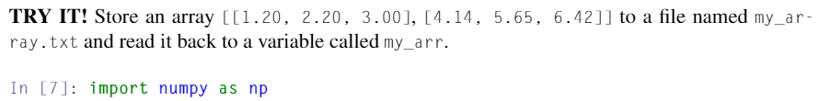
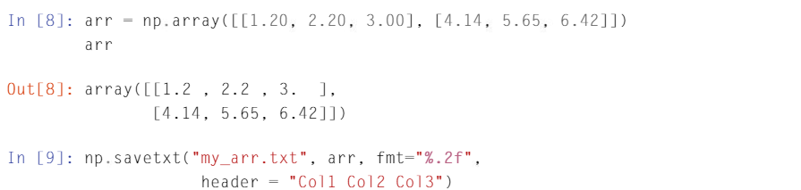
Dealing with Numbers and Arrays
We can use NumPy package to directly save/read an array.
An example below presents how to store a NumPy array in the file.

Slide 6
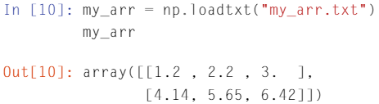
Dealing with Numbers and Arrays (cont.)
Reading a NumPy array from the file.

Slide 7
CSV File
Often, scientific data are stored in the comma-separated values (CSV) file format.
Delimited text file that uses a comma to separate values in the file.
Useful to format and store large tables of data (numbers and text) in a plain text.
Each line (row) in the data is one data record, and each record consists of one or more fields separated by commas.
We can use Microsoft Excel to visualize the rows and columns.
We can use NumPy package in Python to deal with CSV file.

Slide 8
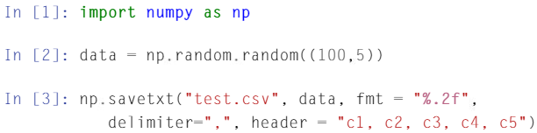
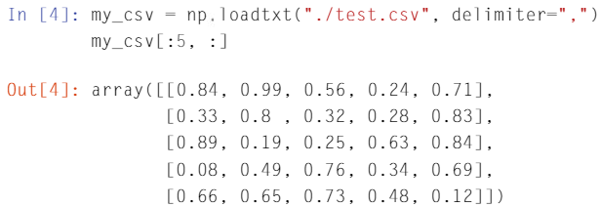
Writing and Opening a CSV file
Writing
Reading

Slide 9
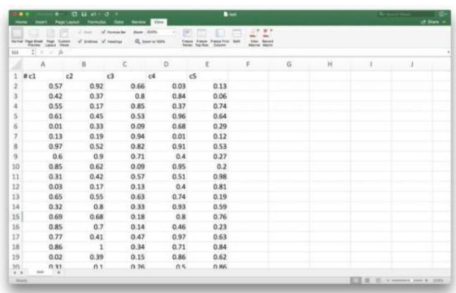
Opening CSV file using MS Excel

Slide 10
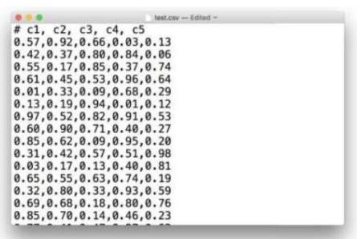
Opening CSV file using a Text Editor

Slide 11
Pickle File
pickle module is used
In a pickle file, we can store serialized objects which can be dictionaries, tuples, lists or any other data type.
Pickle serializes the Python object structures into a byte stream and store them on the disk in binary format.

Slide 12
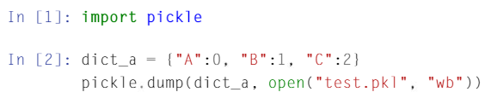
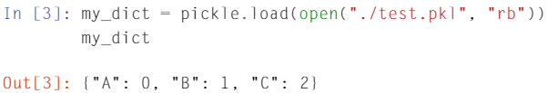
Reading and Writing a Pickle File
Writing to a pickle file
Reading a pickle file

Slide 13
JSON File
json package is used
JSON stands for JavaScript Object Notation.
Used with an extension “.json”.
Pickle file was Python dependent; however, JSON is a language independent data format.
Takes up less space on the disk.
Manipulating a JSON file is faster compared to pickle.

Slide 14
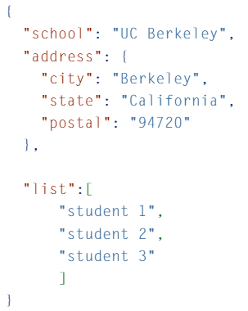
JSON Format

Slide 15
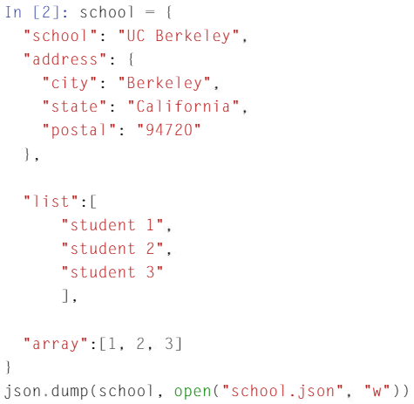

Writing and Reading a JSON File
Writing:
Reading:

